Slide 1
Personal Practices in Data Visualization
Amit Levinson
April 2022

Slide 2
Agenda
We won’t talk about
- How to solve an analytical question
- How to analyze our data
- What graph to fit to our question
We will talk about
Chart clutter
Preattentive attention
Minimalism

Slide 3
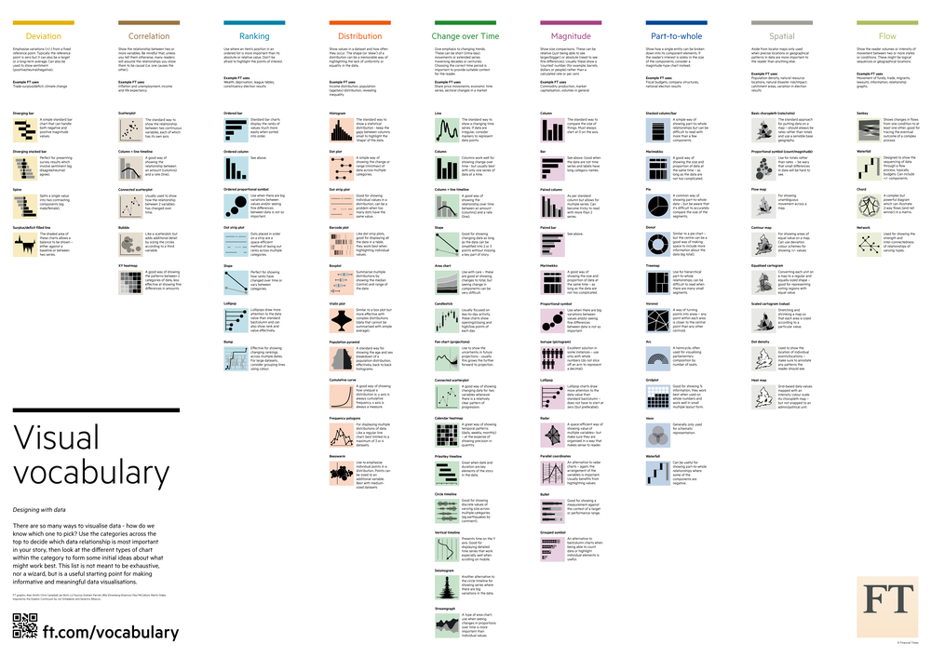
Data Visualization - Examples

Slide 4
Data Visualization
Data visualization is the representation of data through use of common graphics, such as charts, plots, infographics, and even animations. These visual displays of information communicate complex data relationships and data-driven insights in a way that is easy to understand.
~ IBM

Slide 5
Practical example

Slide 6
Analytical request
How has Israel’s life expectancy changed across the years compared to other countries?

Slide 7
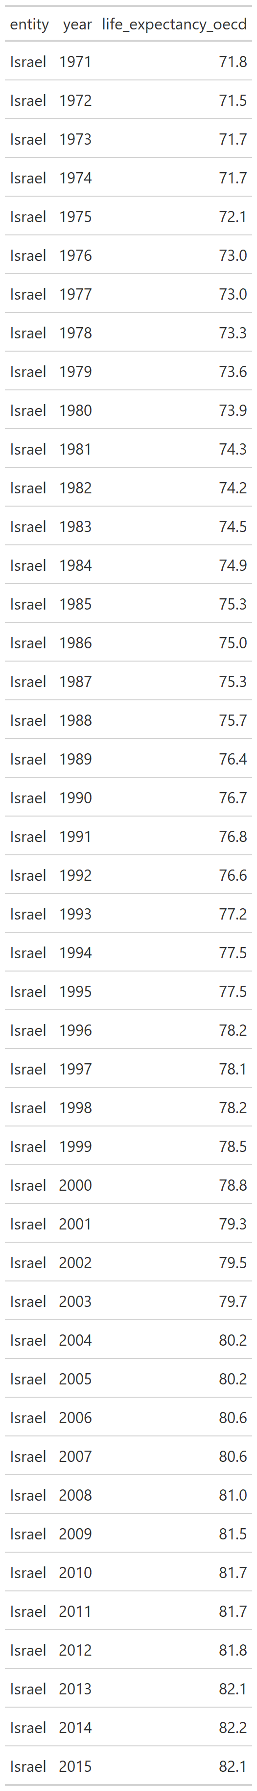

Present the data

Slide 8
Visualize the data
What data do we need?
Years over time (1960, 1961… 2022)
Life expectancy recorded in every year (71, 73…)
By Country

Slide 9
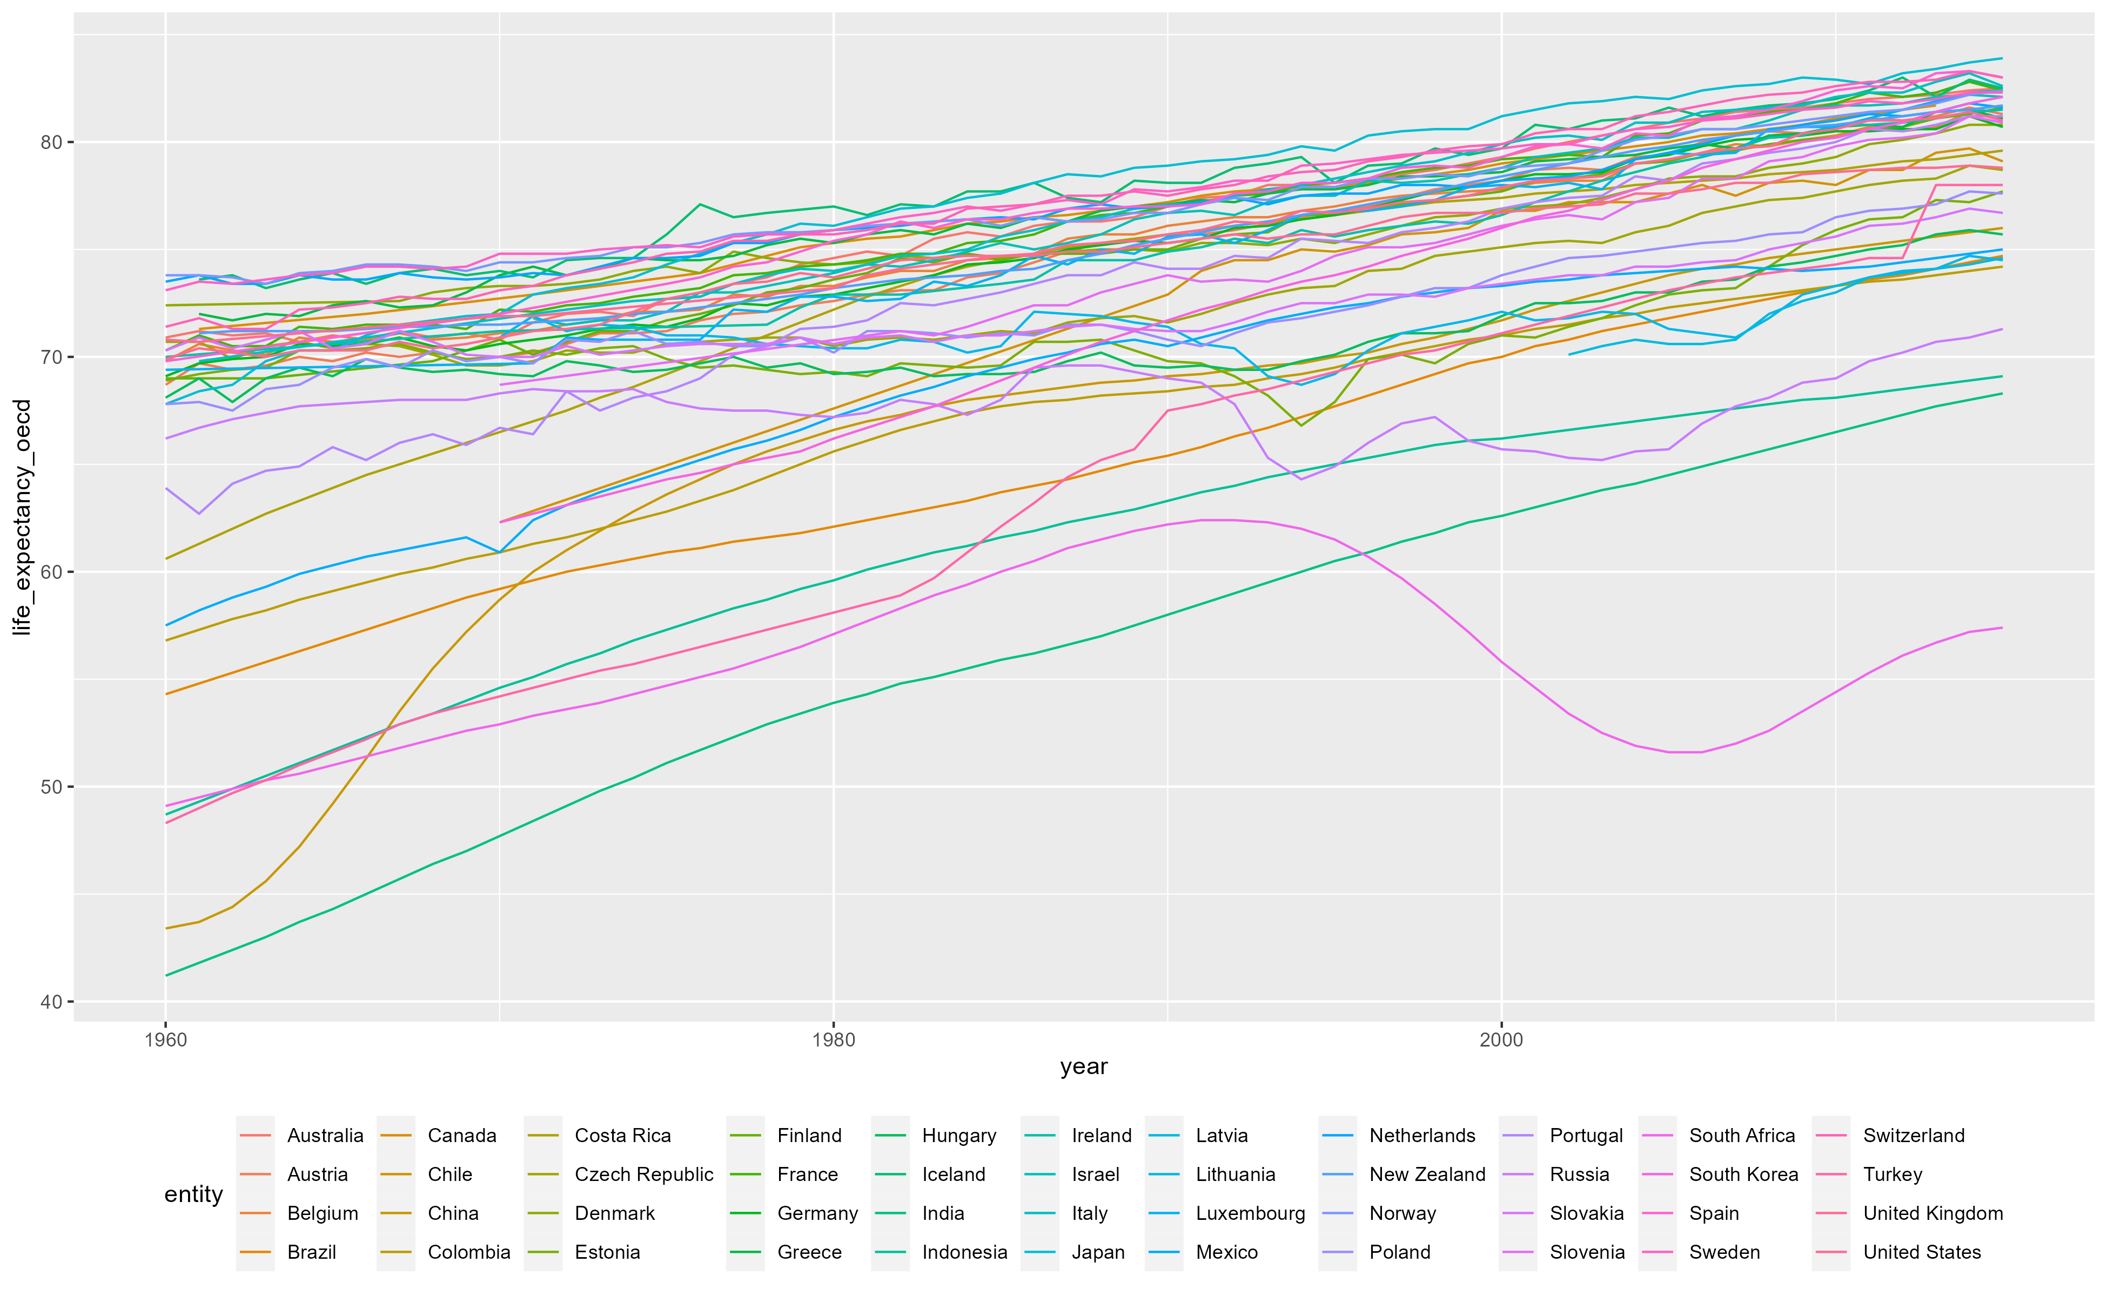
Visualize the data

Slide 10
Amit Levinson
April 2020

Slide 11


What does the plot show? Takeaway?
Does the gray background help us?
Why are we coloring the lines?
Do we need all these gridlines?
??
Is all this necessary?

Slide 12
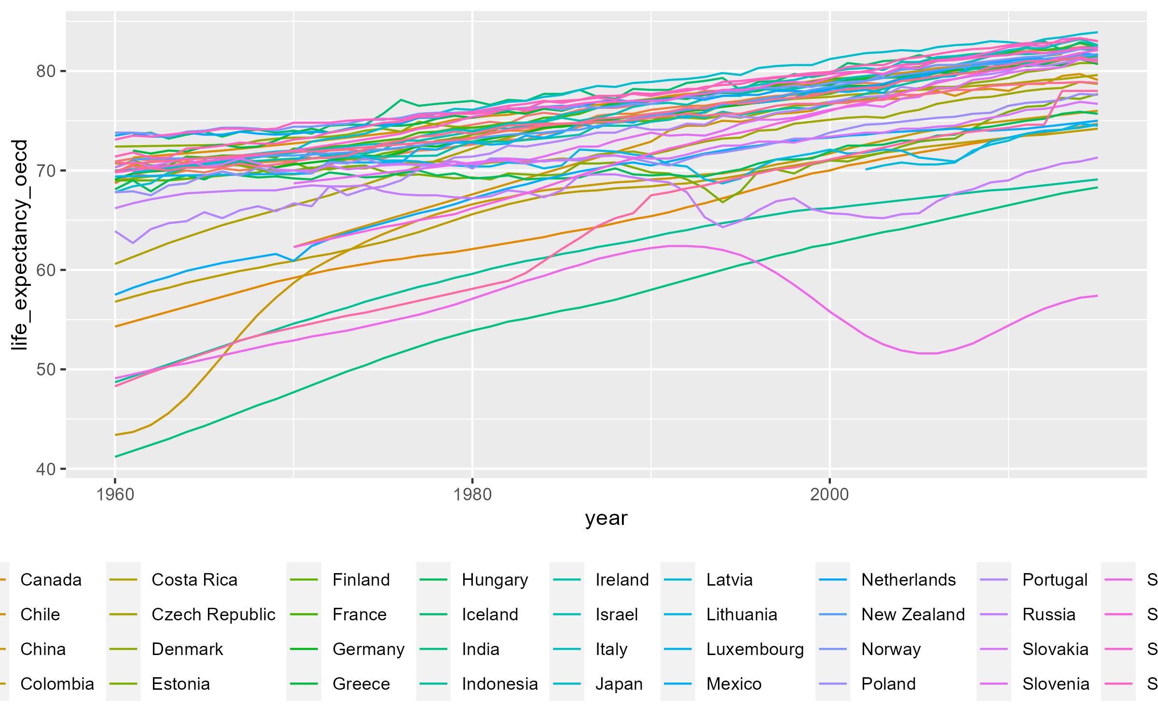
Starting with what we saw

Slide 13
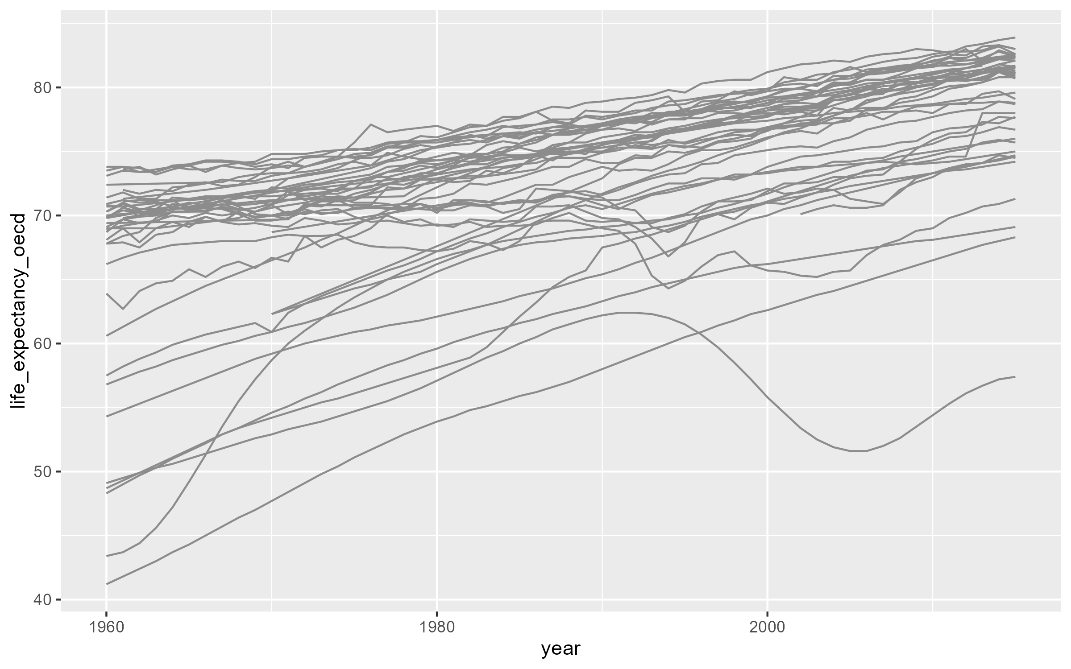
Use Color Sparingly

Slide 14
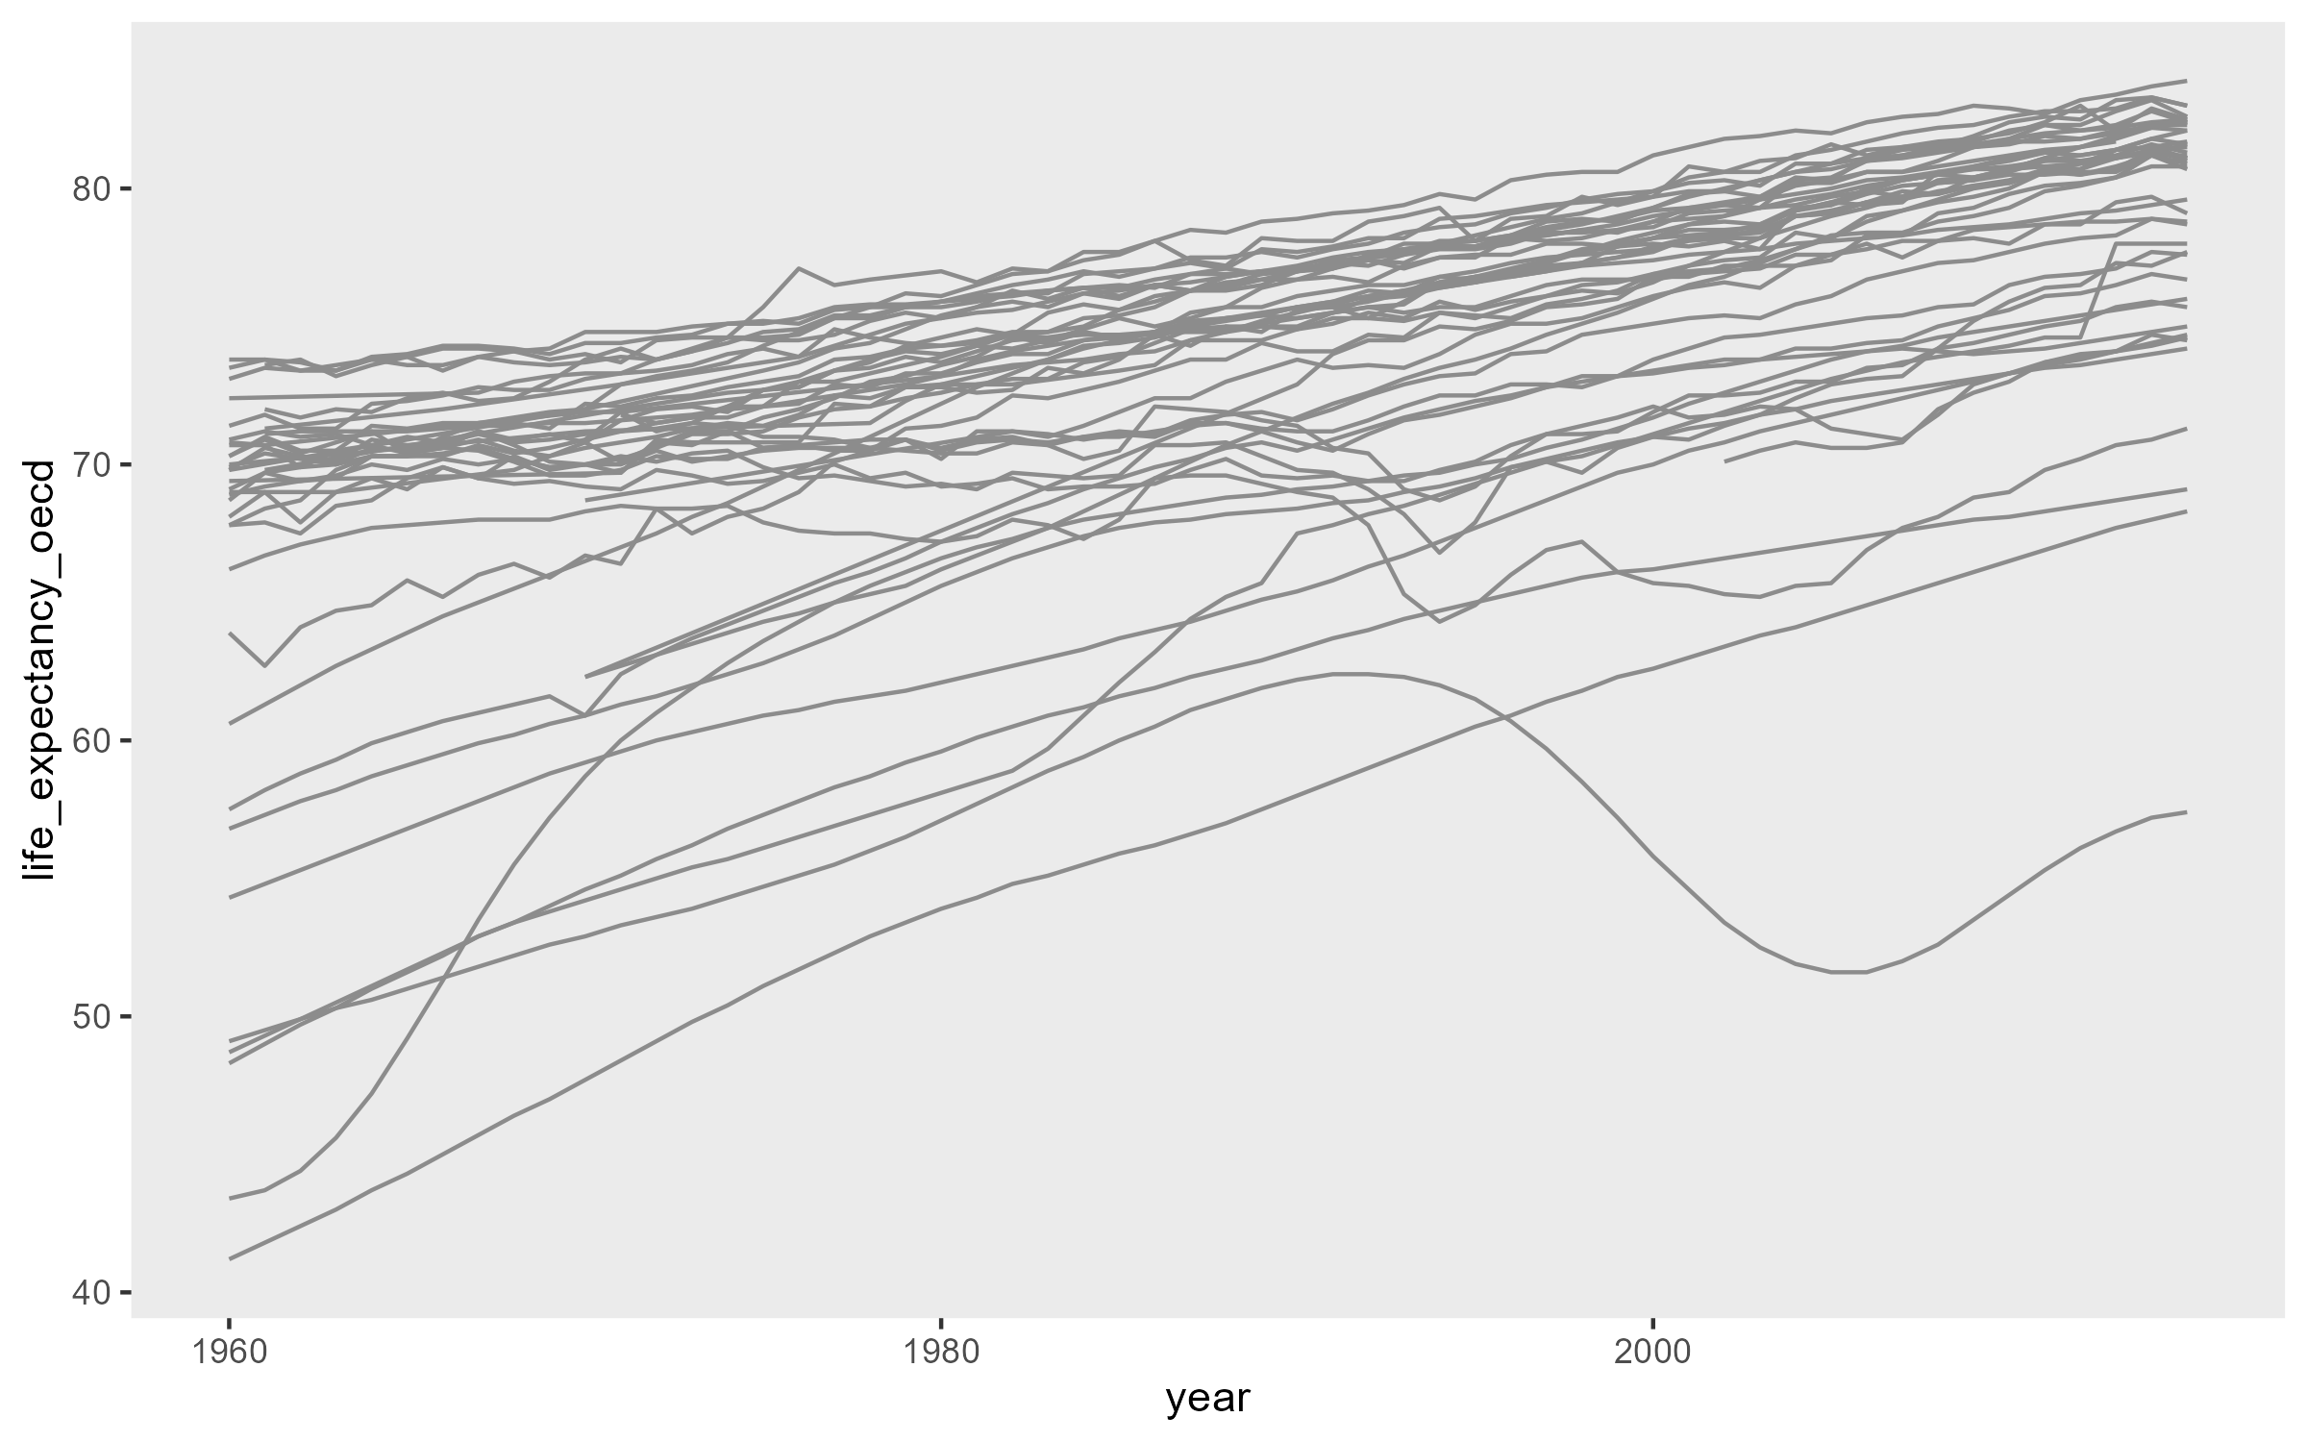
Remove unnecessary clutter

Slide 15
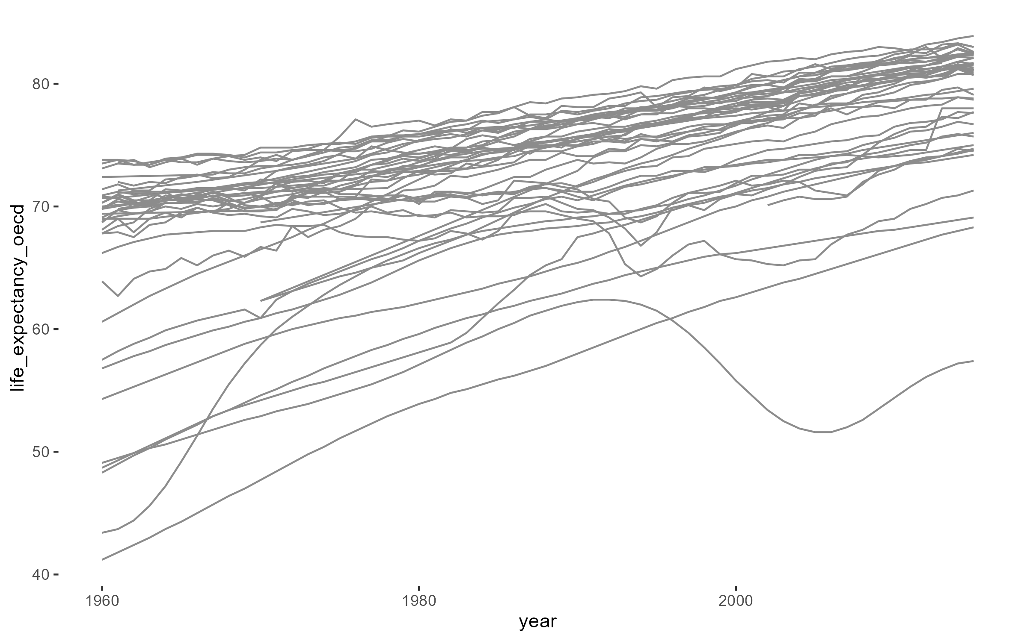
Use Color Sparingly (2)

Slide 16
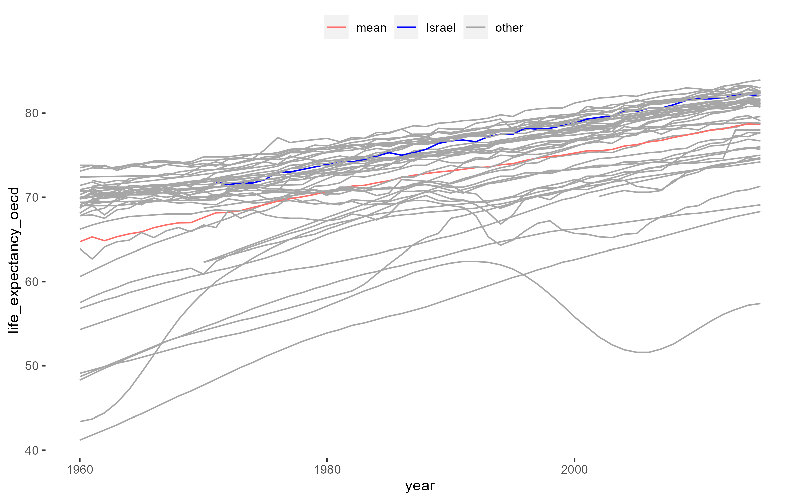
Highlighting

Slide 17
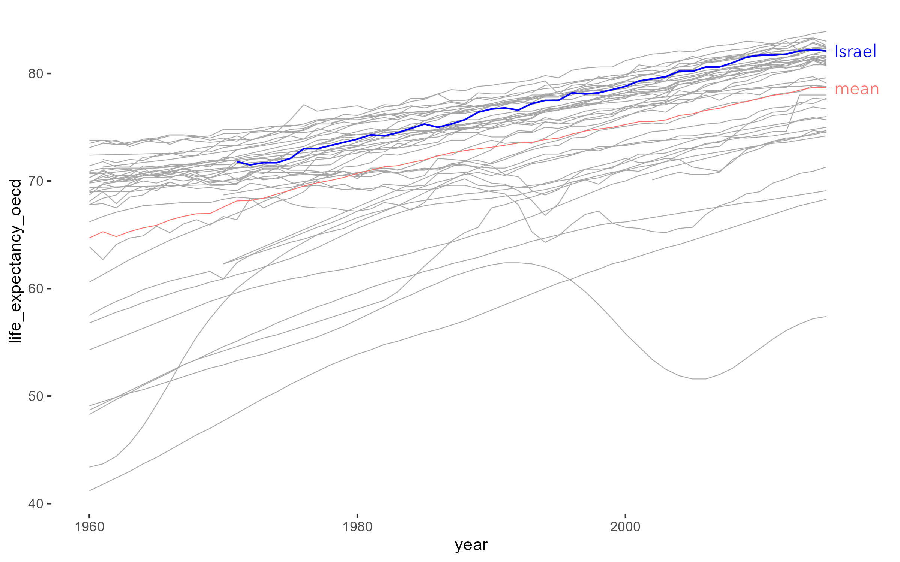
Highlight what’s important

Slide 18
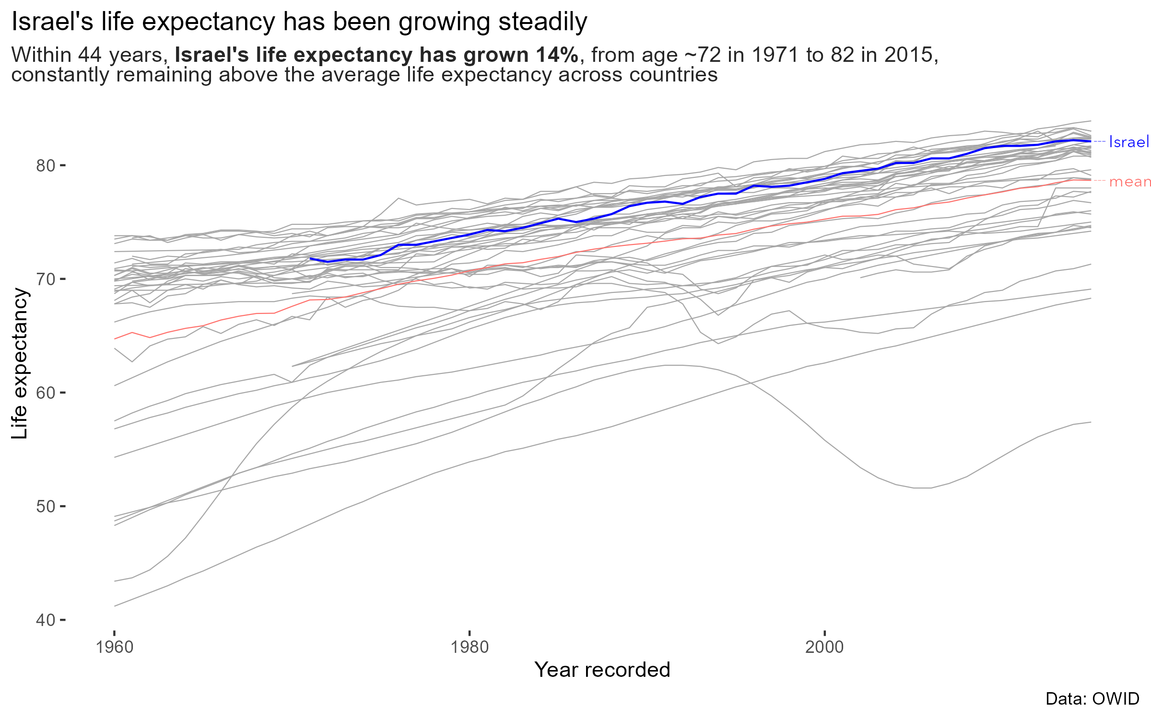
Add context

Slide 19
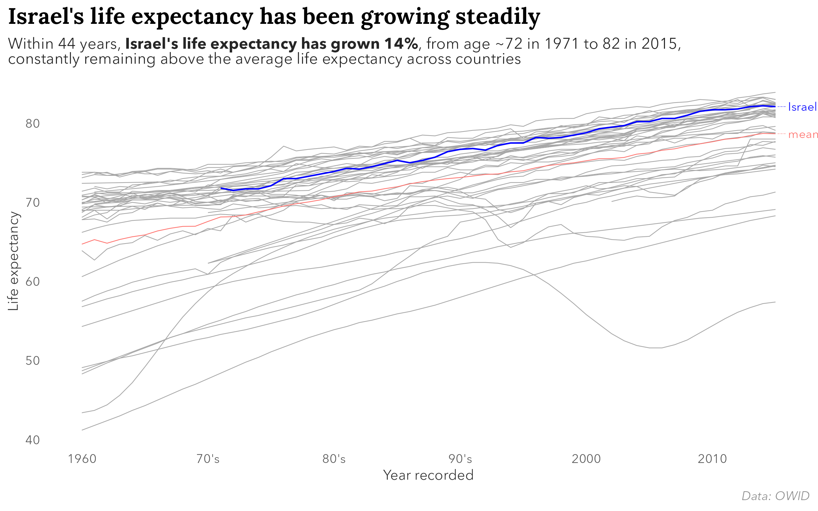
Final Touches

Slide 21
Recap

Slide 22
Chart

Slide 23
Final notes - Preattentive attention
Find Israel
Fiji, French Polynesia, Samoa, Tunisia, Iceland, Ethiopia, Kazakhstan, Mauritius, Namibia, Guam, Cameroon, Tonga, Kenya, Turkey, Afghanistan, Kiribati, India, Finland, Pakistan, Micronesia, Ukraine, Democratic Republic of Congo, Timor, Ghana, Guatemala, Uganda, Serbia, Mali, South Sudan, Angola, Maldives, Botswana, Algeria, South Africa, Burkina Faso, Gambia, Equatorial Guinea, Djibouti, Central African Republic, Eritrea, Mozambique, Malawi, Gabon, Sierra Leone, Guinea, Senegal, Niger, Benin, Sao Tome and Principe, Kyrgyzstan, Lithuania, Liberia, Cote d'Ivoire, Togo, Sudan, Burundi, Rwanda, Guinea-Bissau, Mauritania, Comoros, Tanzania, Swaziland, Mayotte, Zambia, Congo, Lesotho, Philippines, Madagascar, Reunion, Bangladesh, Cape Verde, Western Sahara, United Kingdom, Belarus, Croatia, Indonesia, Ireland, Turkmenistan, Nigeria, Poland, Somalia, New Caledonia, Russia, Tajikistan, Norway, Saint Vincent and the Grenadines, Vietnam, Zimbabwe, North Korea, South Korea, Guadeloupe, Sweden, Chad, Myanmar, Saint Lucia, Mexico, Bhutan, Uzbekistan, Haiti, Cuba, Cambodia, France, Bosnia and Herzegovina, Yemen, Dominican Republic, Albania, Montenegro, Thailand, Martinique, Malaysia, Macedonia, Slovenia, Mongolia, Portugal, Laos, Barbados, Moldova, Nepal, Iran, Kuwait, United States Virgin Islands, Antigua and Barbuda, Singapore, Azerbaijan, Macao, Nicaragua, Netherlands Antilles, Aruba, Hong Kong, China, Armenia, Bahamas, Latvia, Denmark, Georgia, Greece, Grenada, Vanuatu, Solomon Islands, Lebanon, Puerto Rico, Bahrain, Trinidad and Tobago, Egypt, Libya, Morocco, El Salvador, United Arab Emirates, Sri Lanka, Qatar, Italy, Syria, Iraq, Hungary, Taiwan, Cyprus, Jordan, Jamaica, Romania, Belize, Israel, Palestine, Saudi Arabia, Oman, French Guiana, Brazil, Brunei, Papua New Guinea, Chile, Colombia, Malta, Greenland, Germany, Ecuador, Suriname, Venezuela, Bolivia, Guyana, Panama, Spain, Honduras, Costa Rica, Estonia, Japan, Uruguay, Netherlands, United States, Paraguay, Austria, Peru, Slovakia, Belgium, Argentina, Western Africa, Low-income countries, Bulgaria, Australia, New Zealand, Czech Republic, Least developed countries, Sub-Saharan Africa, Southern Asia, Eastern Africa, South-Central Asia, Middle Africa, Africa, Luxembourg, Seychelles, Switzerland, Lower-middle-income countries, Canada, Melanesia, Less developed regions, excluding China, Less developed regions, Northern Africa, Asia, Less developed regions, excluding least developed countries, Middle-income countries, Western Asia, Eastern Asia, South-Eastern Asia, Upper-middle-income countries, World, Southern Africa, Central America, Polynesia, Latin America and the Caribbean, Caribbean, South America, Micronesia (region), Micronesia (country), Central Asia, Eastern Europe, Serbia (including Kosovo), Curacao, Oceania, Europe, Southern Europe, More developed regions, High-income countries, Western Europe, Northern Europe, Northern America, Channel Islands, and Australia/New Zealand

Slide 24
Final notes - Preattentive attention
Find Israel
Fiji, French Polynesia, Samoa, Tunisia, Iceland, Ethiopia, Kazakhstan, Mauritius, Namibia, Guam, Cameroon, Tonga, Kenya, Turkey, Afghanistan, Kiribati, India, Finland, Pakistan, Micronesia, Ukraine, Democratic Republic of Congo, Timor, Ghana, Guatemala, Uganda, Serbia, Mali, South Sudan, Angola, Maldives, Botswana, Algeria, South Africa, Burkina Faso, Gambia, Equatorial Guinea, Djibouti, Central African Republic, Eritrea, Mozambique, Malawi, Gabon, Sierra Leone, Guinea, Senegal, Niger, Benin, Sao Tome and Principe, Kyrgyzstan, Lithuania, Liberia, Cote d'Ivoire, Togo, Sudan, Burundi, Rwanda, Guinea-Bissau, Mauritania, Comoros, Tanzania, Swaziland, Mayotte, Zambia, Congo, Lesotho, Philippines, Madagascar, Reunion, Bangladesh, Cape Verde, Western Sahara, United Kingdom, Belarus, Croatia, Indonesia, Ireland, Turkmenistan, Nigeria, Poland, Somalia, New Caledonia, Russia, Tajikistan, Norway, Saint Vincent and the Grenadines, Vietnam, Zimbabwe, North Korea, South Korea, Guadeloupe, Sweden, Chad, Myanmar, Saint Lucia, Mexico, Bhutan, Uzbekistan, Haiti, Cuba, Cambodia, France, Bosnia and Herzegovina, Yemen, Dominican Republic, Albania, Montenegro, Thailand, Martinique, Malaysia, Macedonia, Slovenia, Mongolia, Portugal, Laos, Barbados, Moldova, Nepal, Iran, Kuwait, United States Virgin Islands, Antigua and Barbuda, Singapore, Azerbaijan, Macao, Nicaragua, Netherlands Antilles, Aruba, Hong Kong, China, Armenia, Bahamas, Latvia, Denmark, Georgia, Greece, Grenada, Vanuatu, Solomon Islands, Lebanon, Puerto Rico, Bahrain, Trinidad and Tobago, Egypt, Libya, Morocco, El Salvador, United Arab Emirates, Sri Lanka, Qatar, Italy, Syria, Iraq, Hungary, Taiwan, Cyprus, Jordan, Jamaica, Romania, Belize, Israel, Palestine, Saudi Arabia, Oman, French Guiana, Brazil, Brunei, Papua New Guinea, Chile, Colombia, Malta, Greenland, Germany, Ecuador, Suriname, Venezuela, Bolivia, Guyana, Panama, Spain, Honduras, Costa Rica, Estonia, Japan, Uruguay, Netherlands, United States, Paraguay, Austria, Peru, Slovakia, Belgium, Argentina, Western Africa, Low-income countries, Bulgaria, Australia, New Zealand, Czech Republic, Least developed countries, Sub-Saharan Africa, Southern Asia, Eastern Africa, South-Central Asia, Middle Africa, Africa, Luxembourg, Seychelles, Switzerland, Lower-middle-income countries, Canada, Melanesia, Less developed regions, excluding China, Less developed regions, Northern Africa, Asia, Less developed regions, excluding least developed countries, Middle-income countries, Western Asia, Eastern Asia, South-Eastern Asia, Upper-middle-income countries, World, Southern Africa, Central America, Polynesia, Latin America and the Caribbean, Caribbean, South America, Micronesia (region), Micronesia (country), Central Asia, Eastern Europe, Serbia (including Kosovo), Curacao, Oceania, Europe, Southern Europe, More developed regions, High-income countries, Western Europe, Northern Europe, Northern America, Channel Islands, and Australia/New Zealand

Slide 25
Thank you

